Slide 1
Cloud Computing Introduction
Vu Hoang Viet

Slide 2

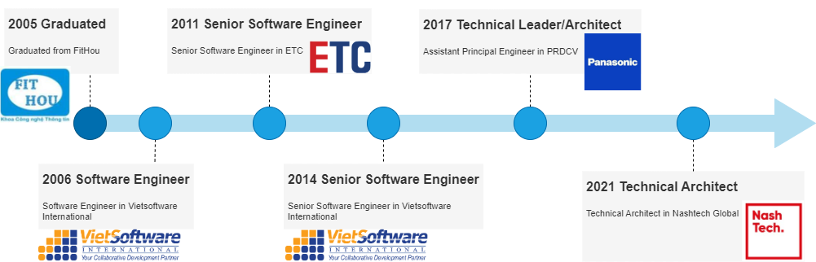
Vu Hoang Viet
Technical Architect
AWS certified solutions architect – Associate

Slide 3

Agenda
Story of Cloud Computing
Cloud Computing concepts
Cloud Computing Environments
Examples

Slide 4
Story of cloud computing
Market and Applications

Slide 5
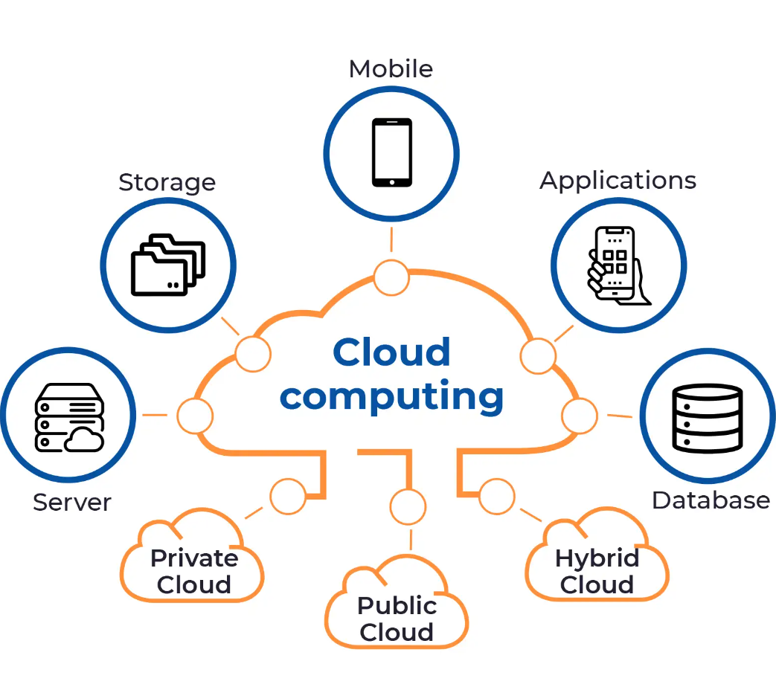
What is Cloud Computing?
Cloud computing is the on-demand delivery of IT resources over the Internet with pay-as-you-go pricing. Instead of buying, owning, and maintaining physical data centers and servers, you can access technology services, such as computing power, storage, and databases, on an as-needed basis from a cloud provider like Amazon Web Services (AWS).

Slide 6
History of Cloud Computing
Amazon.com Web Services launched in 2002
AWS EC2, S3 was introduced in 2006
Microsoft Windows Azure Platform was introduced in October 2008
IBM Bluemix was announced for public beta in February 2014.
Google announced App Engine in April 2008

Slide 7
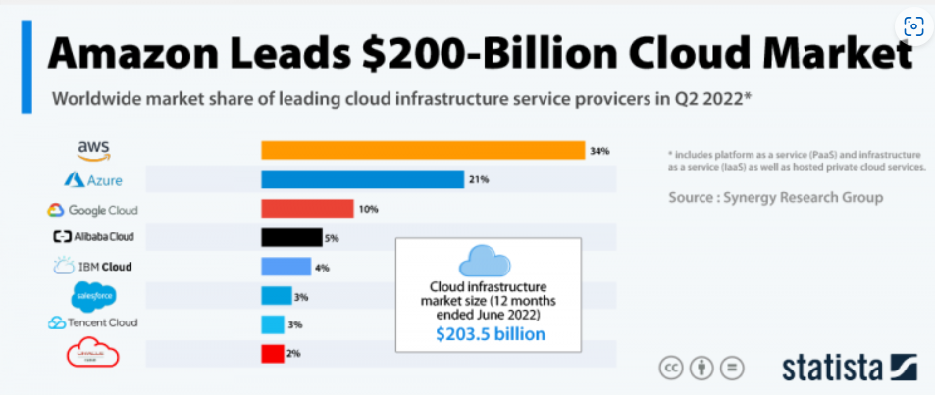
Cloud Computing Providers

Slide 8
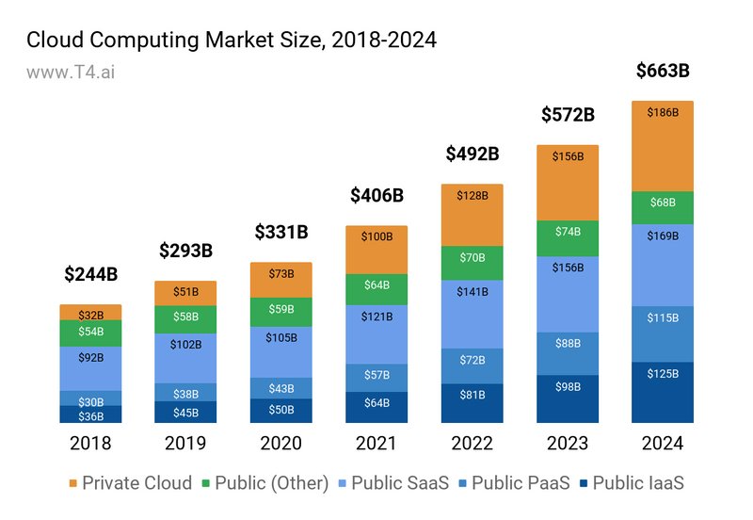
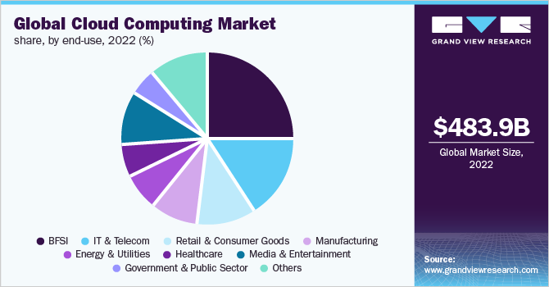
Cloud Computing Market
Cloud Computing
Cloud Computing Market
Cloud Computing Applications

Slide 9
Cloud Computing Concepts
Why and how

Slide 10

The world before Cloud Computing
On-premises
Issues
IT Infrastructure hardware is on-site: network, servers, environments, space, location, power…
Software applications are deployed on large-servers (cluster)
High-cost of Infrastructure investing
Always maintain the highest level of demand
High-cost of Operation and Maintenance
Complex disaster recovery
Complex measurement and monitoring

Slide 11
Cloud Computing Solution
On-demand self-service
Broad network access
Resource pooling
Rapid Elasticity
Measured service
Resource is provided on-demand without human interaction
Organization can control authorization of members to access resource
Access Cloud Resources by any devices and in any networked location (if having permission)
Cloud provider resources are shared by multiple tenants while keeping the data of individual clients hidden from other clients.
Simple to increase resources or decrease wasteful resources
Simple resource measurement and monitoring

Slide 12
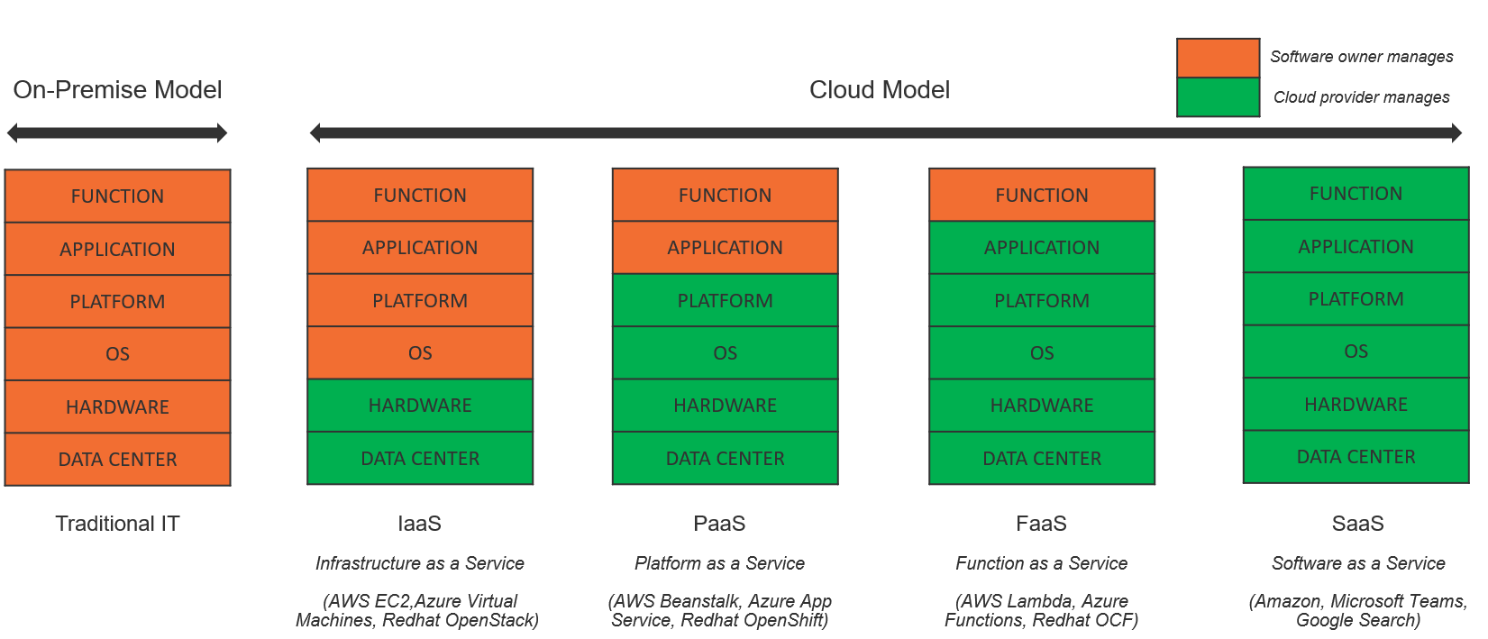
Cloud Computing Service Types

Slide 13
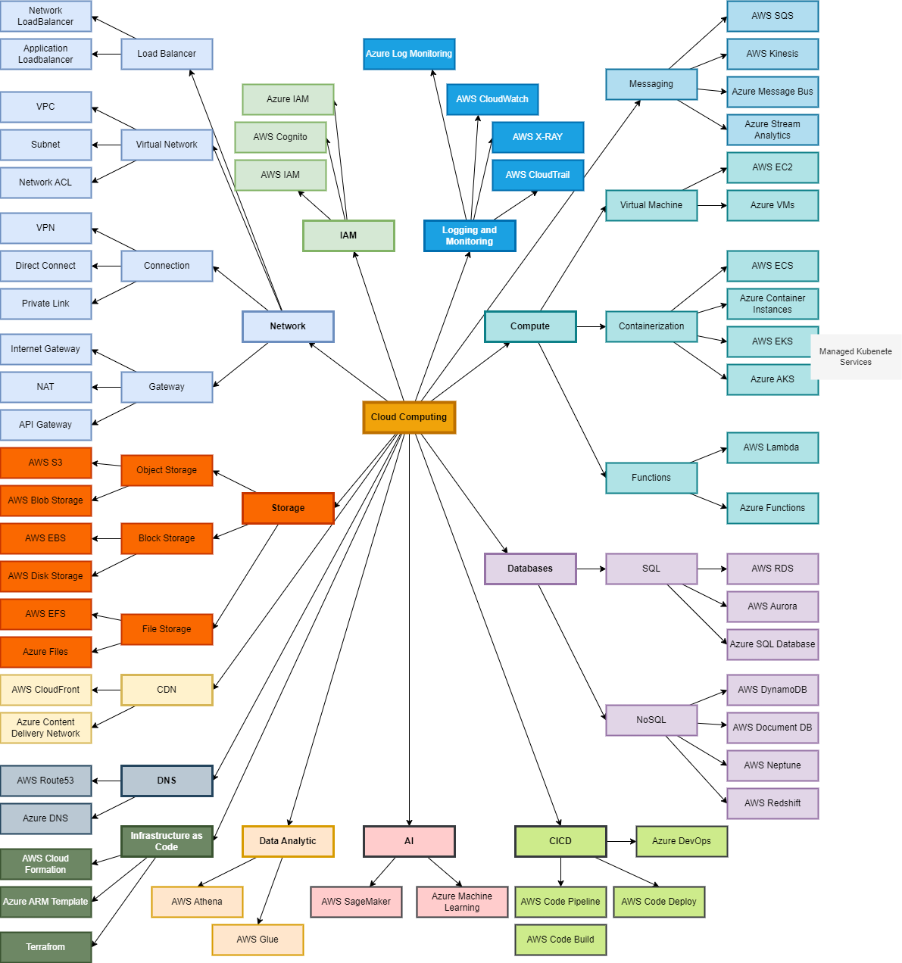
Cloud Common Services
Network
Compute
Storage
Database
CICD
Data Analytic
CDN
DNS
AI
IAM
Infrastructure as Code
Logging and Monitoring
Messaging

Slide 14
CLOUD ENVIRONMENTS
Public, Private, Hybrid and Multi Cloud

Slide 15
Environments
Public Cloud
Private Cloud
Hybrid Cloud
Multi Cloud

Slide 16
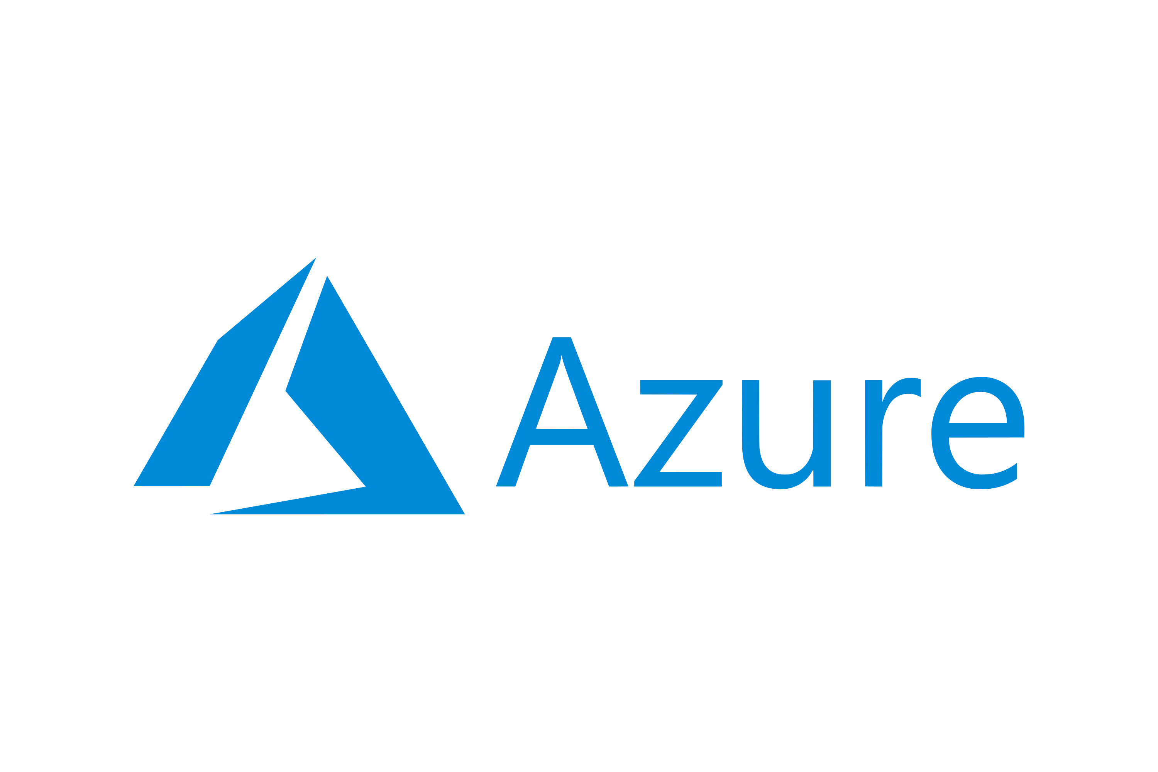
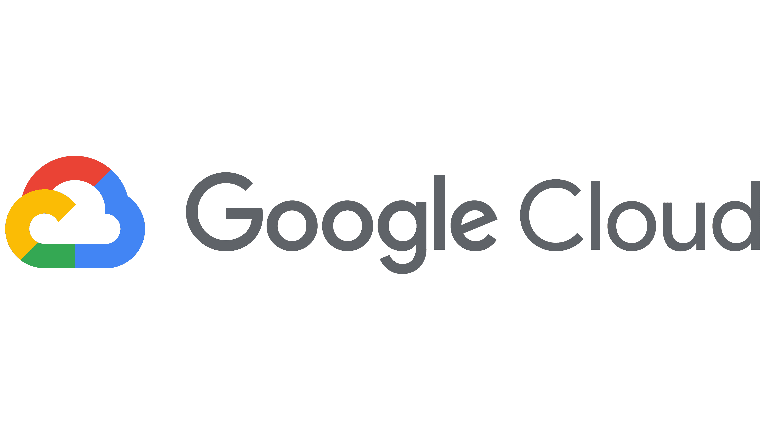

Public Cloud
Provided by Cloud Service Providers
Over Public Internet

Slide 17
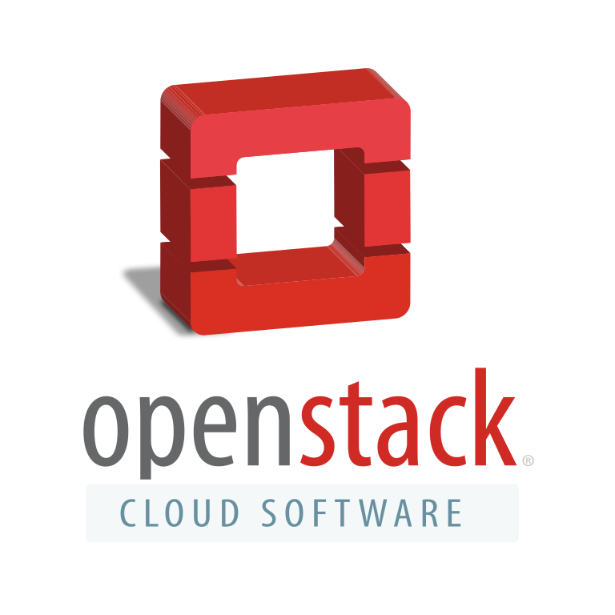
Private Cloud
Is a single-tenant computing infrastructure and environment
Dedicated to the needs and goals of a single organization
The organization doesn’t share resources to other organization
Known as an internal or corporate cloud
Solutions:
AWS Outposts
Azure Stack
Google Distributed Cloud
Cisco AMP Private Cloud
OpenStack
OpenSource Solution

Slide 18
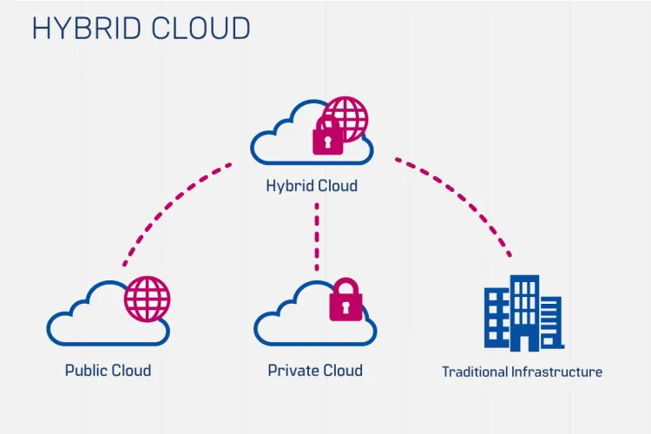
Hybrid Cloud
Mixed computing environment among Public Cloud, Private Cloud and Traditional Infrastructure
Enable to migrate and manage workload between these various cloud environments

Slide 19
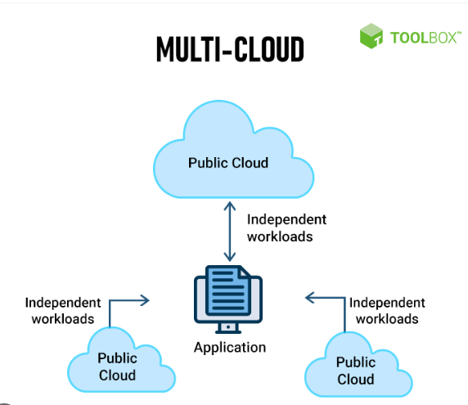
Multi Cloud
Multi-cloud refers to using services from more than one public cloud provider at the same time
Allows your cloud environments to be private, public, or a combination of both.
Flexibility to operate with the best computing environment for each workload
Should be built on top of open source technologies like Kubernetes
provide the flexibility and portability to migrate, build, and optimize applications across multiple clouds

Slide 20
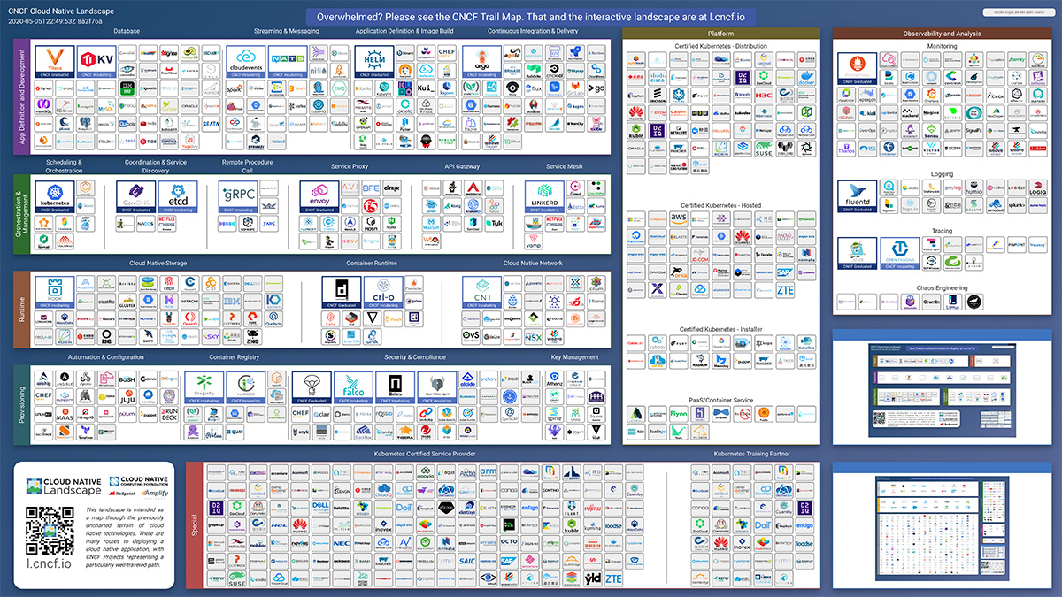
Cloud Native Landscape
CNCF is the open source, vendor-neutral hub of cloud native computing, hosting projects like Kubernetes and Prometheus to make cloud native universal and sustainable
Cloud Native Landscape (cncf.io)

Slide 21
CLOUD Computing examples
Applications of Cloud Computing

Slide 22
Examples
The IoT System:
Working with IoT Devices
Publish Events to Appliance Microservices
Deliver Commands to Appliances (IoT Devices)
The Appliance Microservices
Handle individual appliance business
Facing with End User by Mobile or Web App
Reactive system of appliance controlling

Slide 23
The IoT System

Slide 24
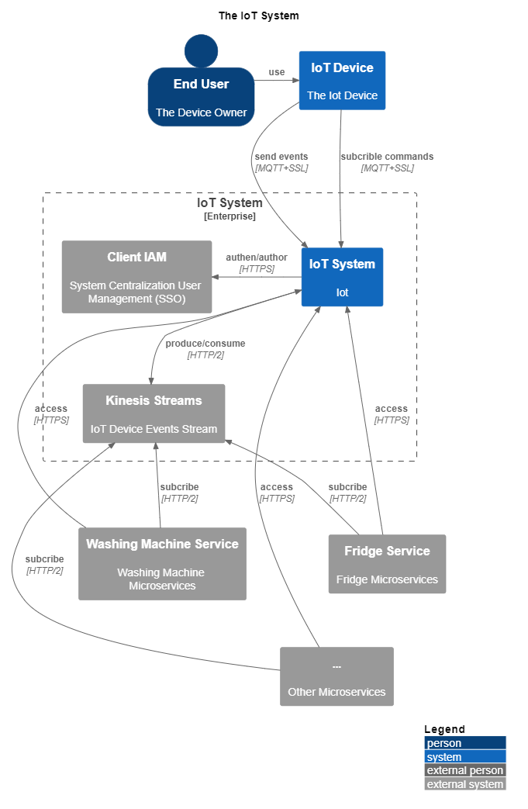
Context
Working with IoT Devices
Publish Events to Device Microservices
Endpoint for working with Appliances via MQTT
Deliver commands to Appliances (IoT Devices)
Centralization of User management (SSO)

Slide 25
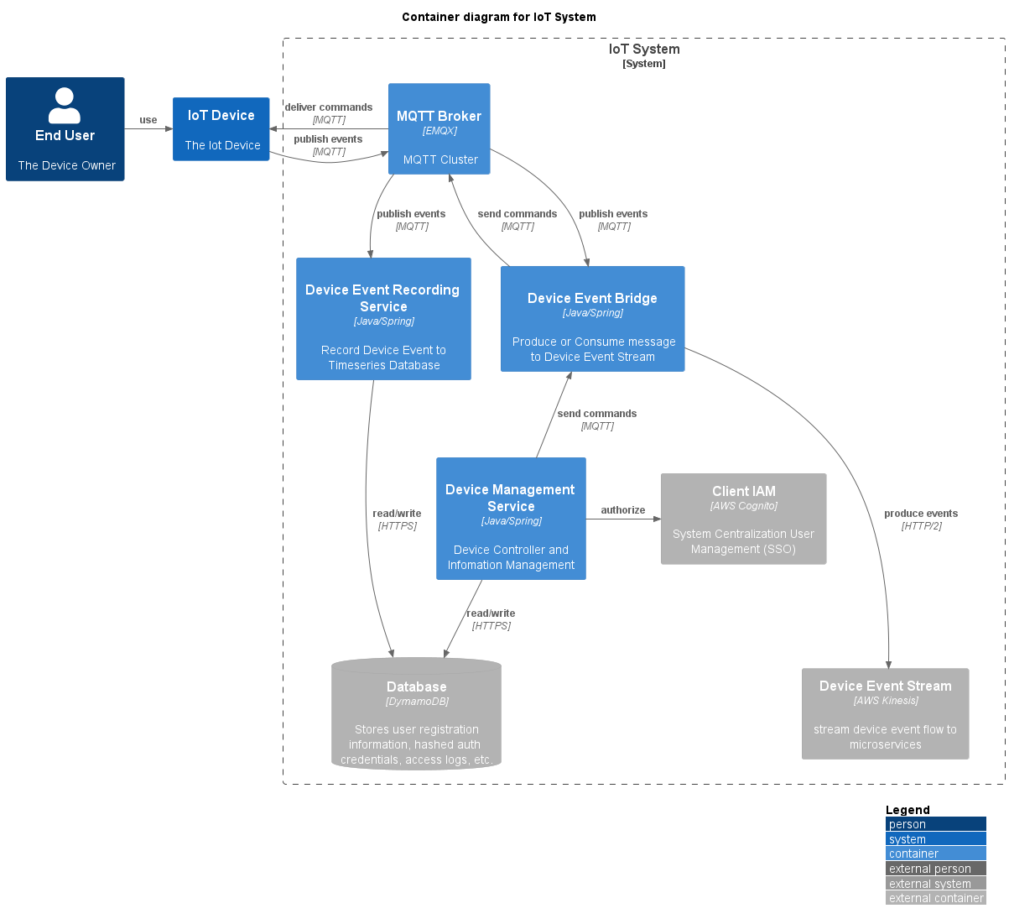
Components
MQTT Broker:
Keep connection channel to devices
Send commands and receive device events
Publish to Device Event bridge
Device Event Bridge
Pre-process Device Events
Produce to Device Event Stream (Kinesis)
Receive Command and send to MQTT broker
Device Event Recording Service
Record device events to time series database
Device Management Service
Manage Device Information
Receive device command and send to Device Event Bridge

Slide 26
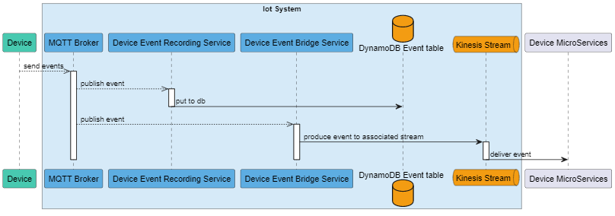
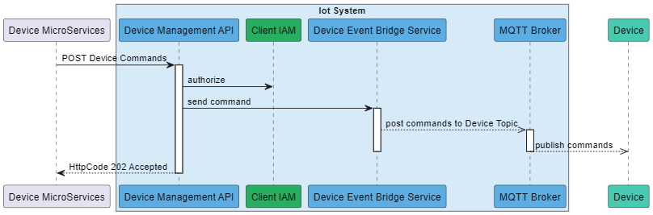
Core Workflow
Device send events
Device receive commands

Slide 27
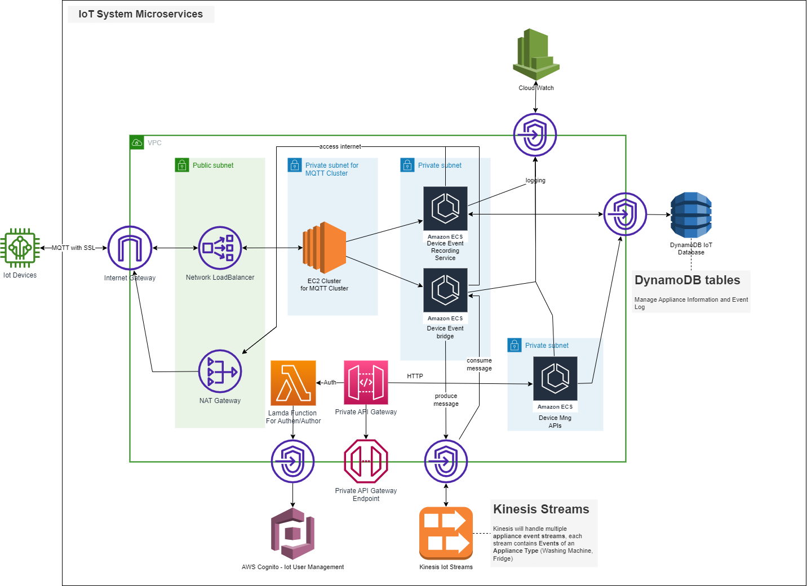
Cloud Architecture
EC2 Instances with Auto Scaling Group for MQTT Server
DynamoDB tables:
Device Information Database
Device Event Database:
Protected API Gateway:
Access to Private APIs that represent Device Info
ECS for business processing:
Handle Application Events
Transfer to Kinesis Stream
Device Management
Kinesis Streams:
handle multiple device event streams, each stream contains Events of and Device Type (Washing Machine, Fridge)
AWS Cognito for User Management
Networking:
VPC and Subnet
Internet Gateway
Nat Gateway to access to Internet
Network load balancer
VPC Endpoints

Slide 28
The Appliance Microservices

Slide 29
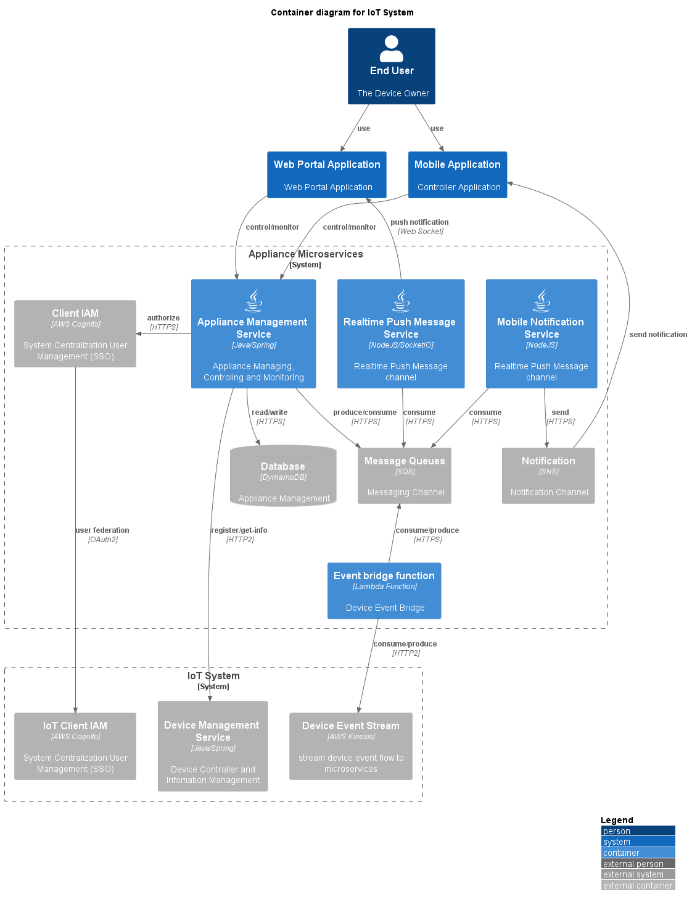
Components
End User Applications:
Web Portal: Web Application to control and manage devices
Mobile Application: Mobile Application to control and manage devices
Application Management Service
Provide Rest APIs facing to Web/Mobile applications
User and Device registration
Device State Management
Send Commands to devices
Device event processing
Realtime Push Notification Message
Provide Socket IO channels (Websocket)
Realtime deliver messages to Web/Mobile Application
Mobile Notification Service
Deliver Notification to Mobile (via SNS)
Event Bridge function
Consume and convert message from Kinesis Stream and deliver to SNS
Produce command to Kinesis Stream for Device control propose

Slide 30
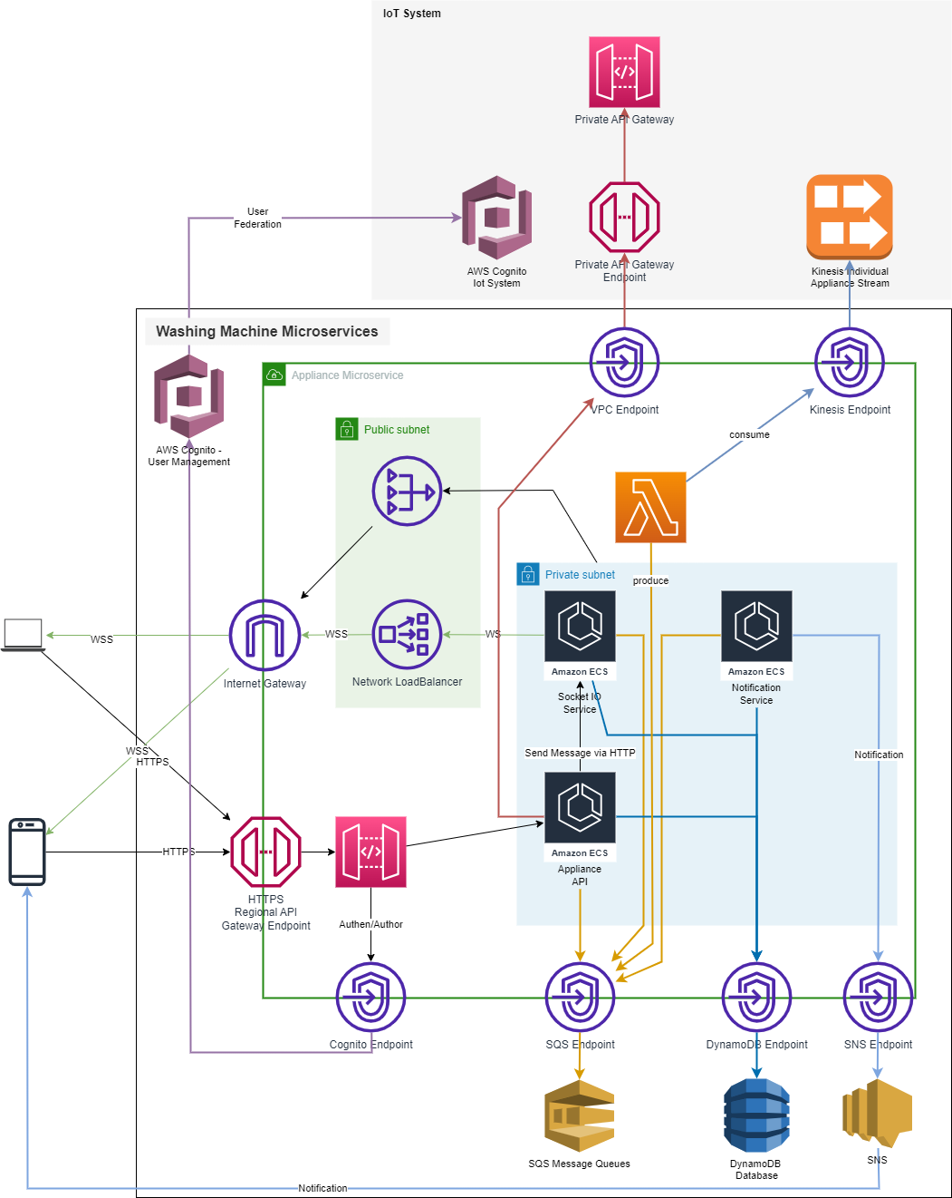
Appliance Microservices
Washing machine Microservice
Subscribe Device Events from IoT System Kinesis Stream
Working with End User
Using difference account with IoT System
Architecture for:
Washing Machine Microservices
Fridge Microservices
Vacuum Microservices
Kitchen devices Microservices

Slide 31




Thank you
Vu Hoang Viet
vietvuhoang@gmail.com

